Slide 1
OVERVIEW

Slide 2
What is a solar cooker?

Slide 3
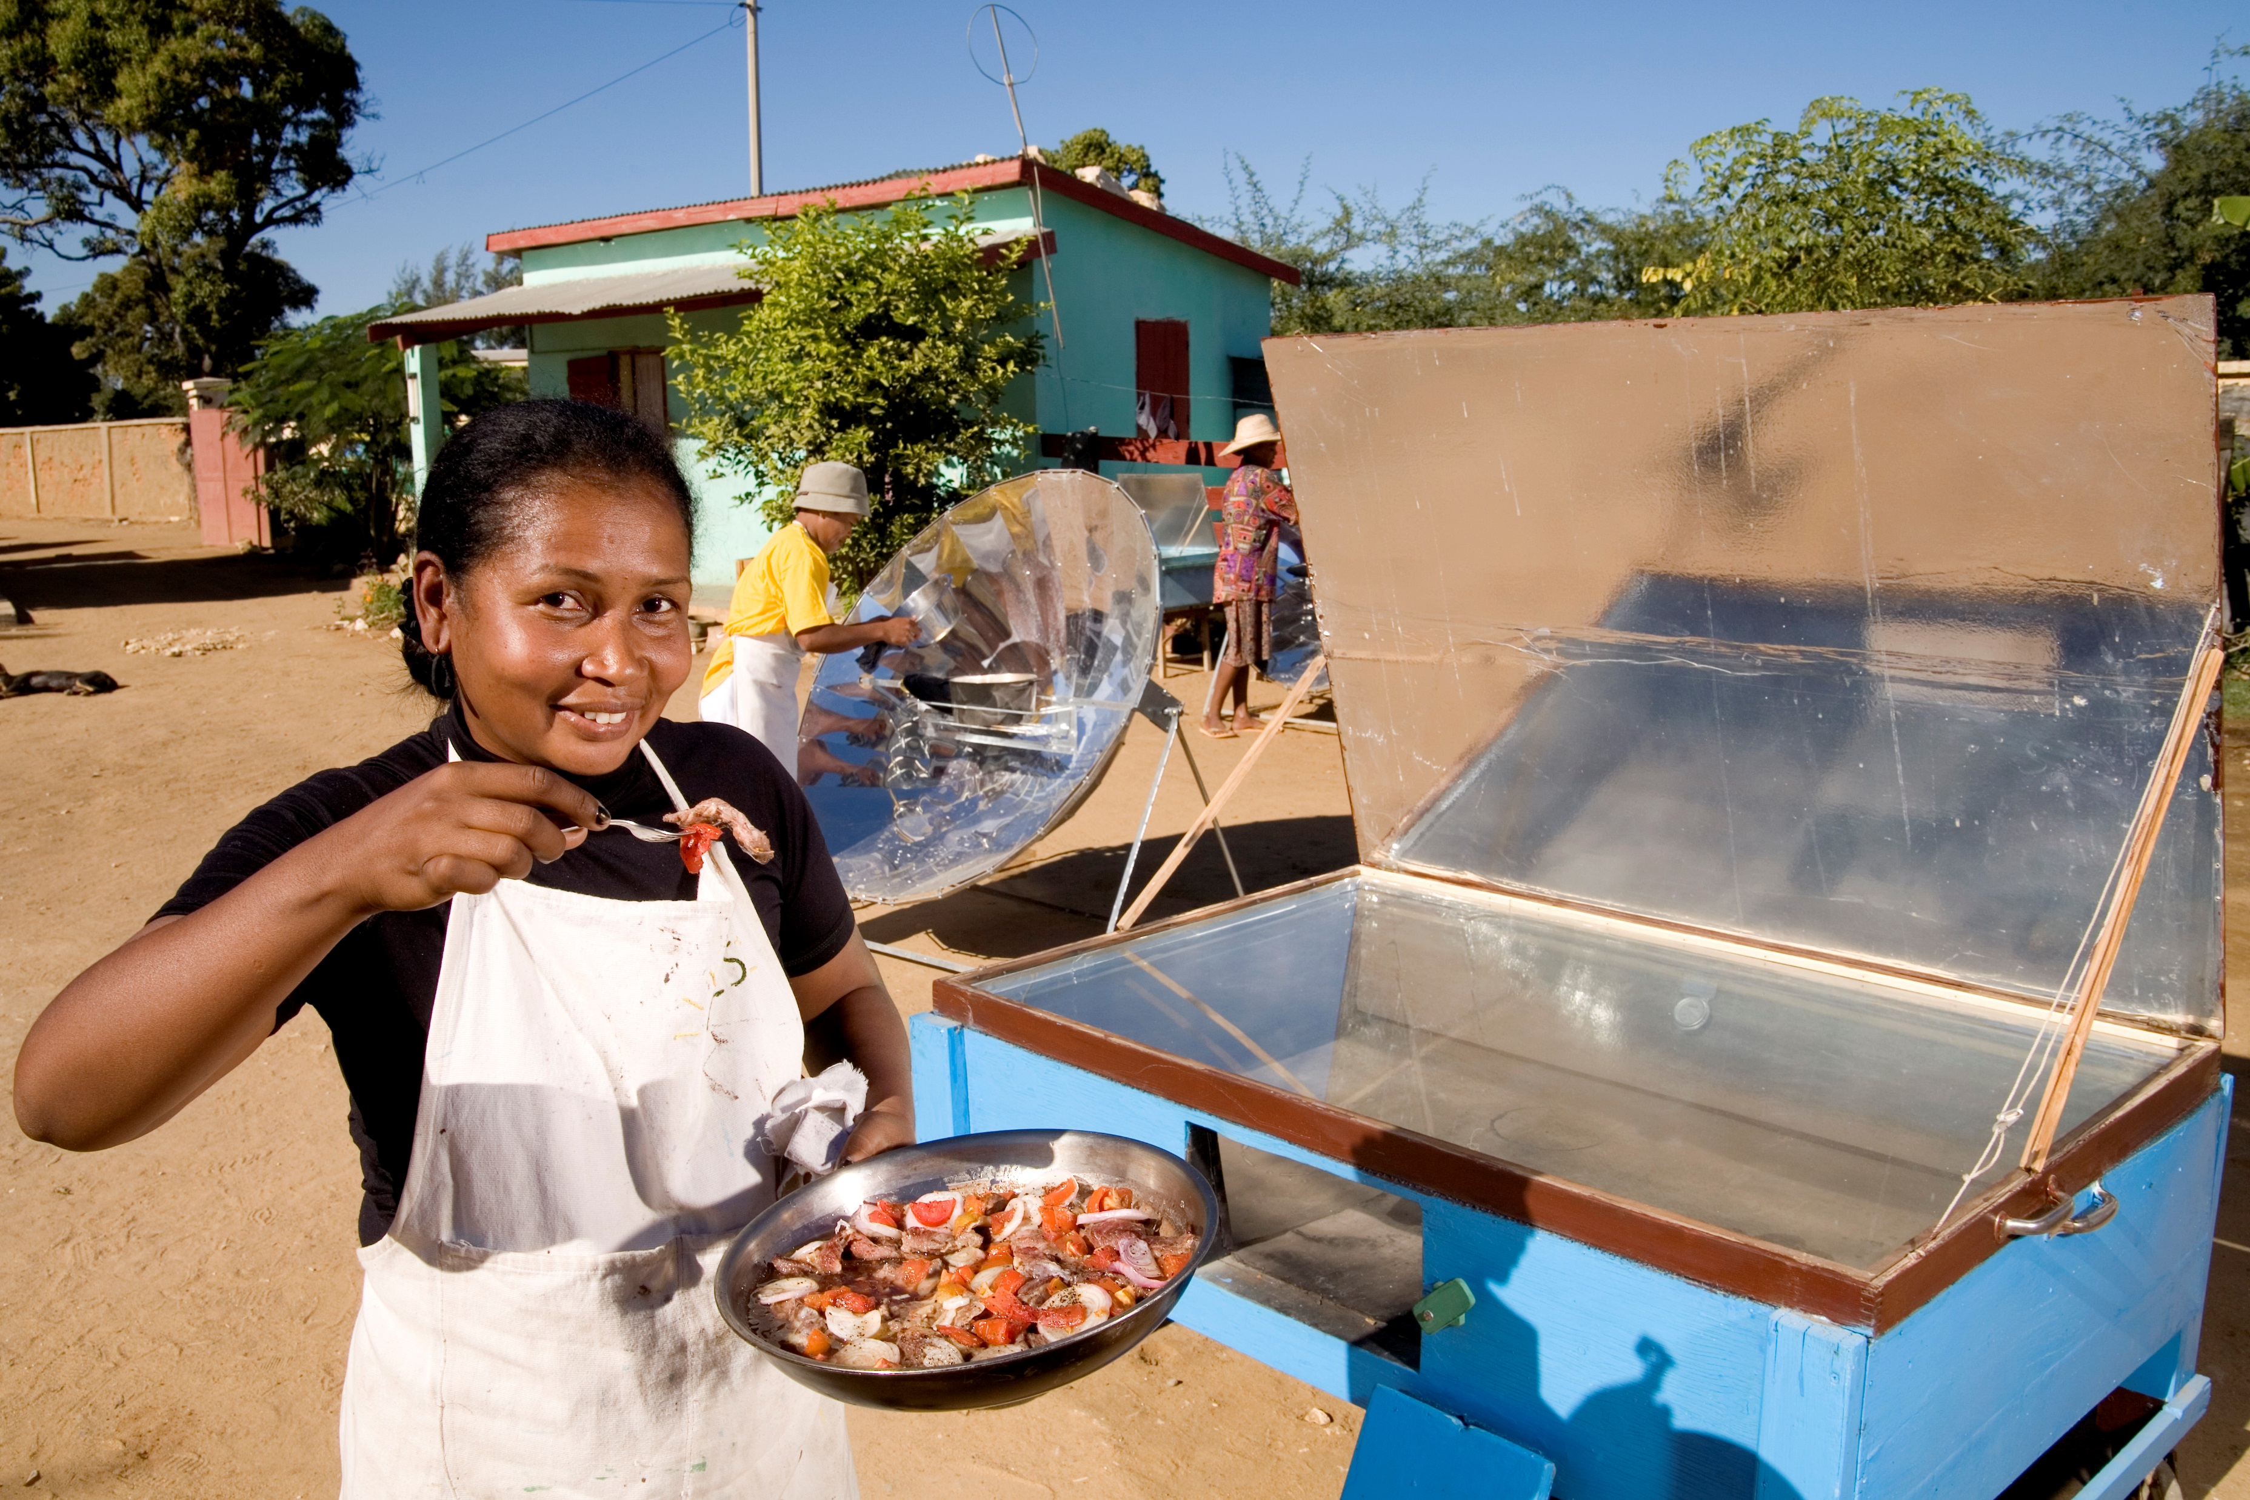
What is a solar cooker?
A solar cooker is a device which uses the energy of direct sunlight to heat, cook or pasteurize drink.
Solar cooking is often used where minimal fuel consumption is important, or the danger of accidental fires is high, and the health and environmental consequences of alternatives are severe.
Photo Credit: Regula Ochsner, ADES-Madagascar, 2017

Slide 4
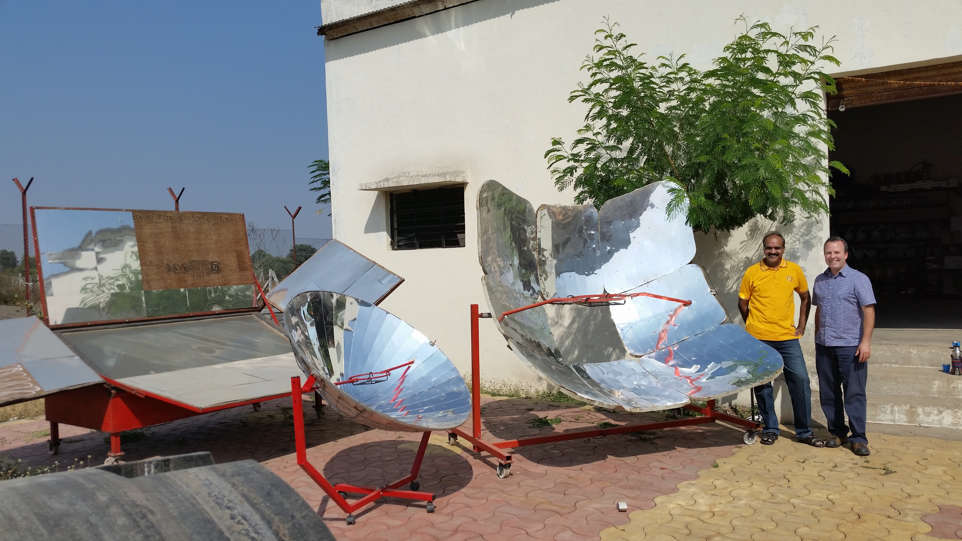
What is a solar cooker?
The three most common types of solar cookers are box cookers, curved concentrators (parabolic) and panel cookers. Hundreds — if not thousands — of variations on these basic types exist.
Several large-scale solar cooking systems have been developed to meet the needs of institutions worldwide.

Slide 5
Why is solar cooking important?

Slide 6
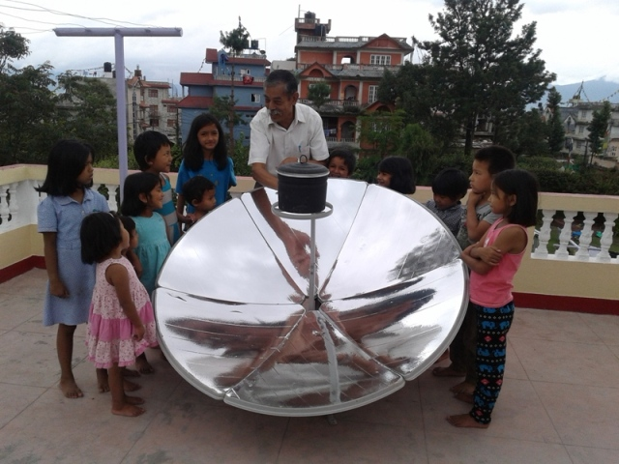
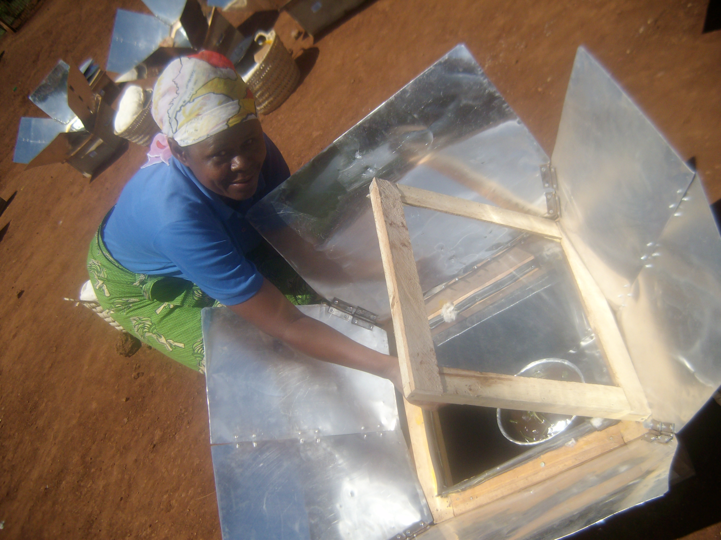
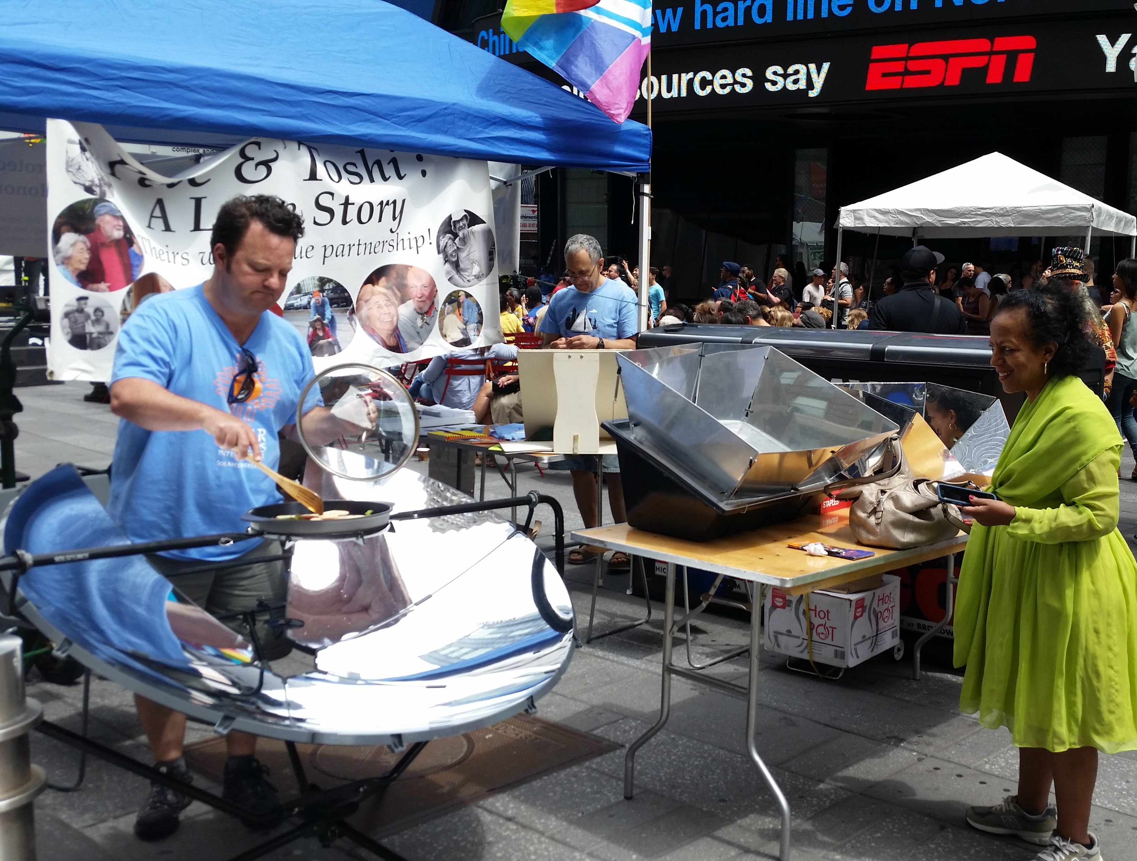
Why solar cooking?
Nutritious meals
Can be used for drying food
Can pasteurize water
Zero time (or danger) from collecting biomass fuel

Slide 7
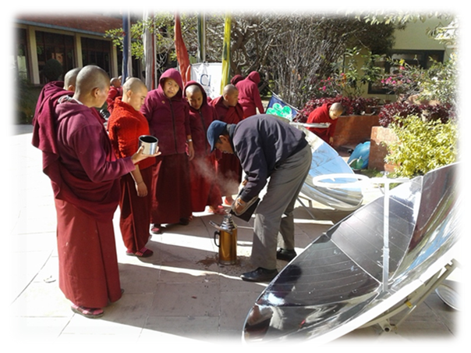
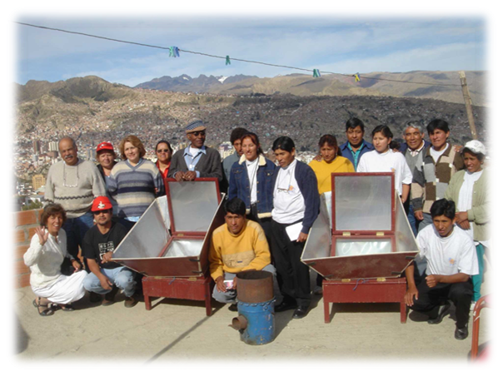
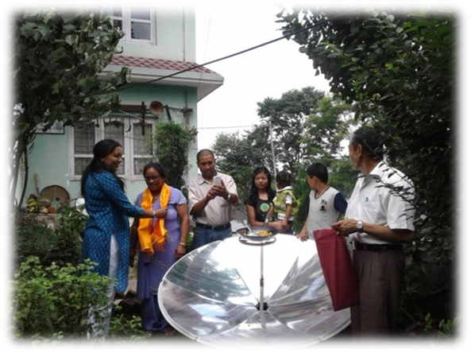
Why solar cooking?
Zero fuel cost
Zero air pollution
Zero greenhouse gas emission
Zero inhalation of smoke
Reduces deforestation

Slide 8
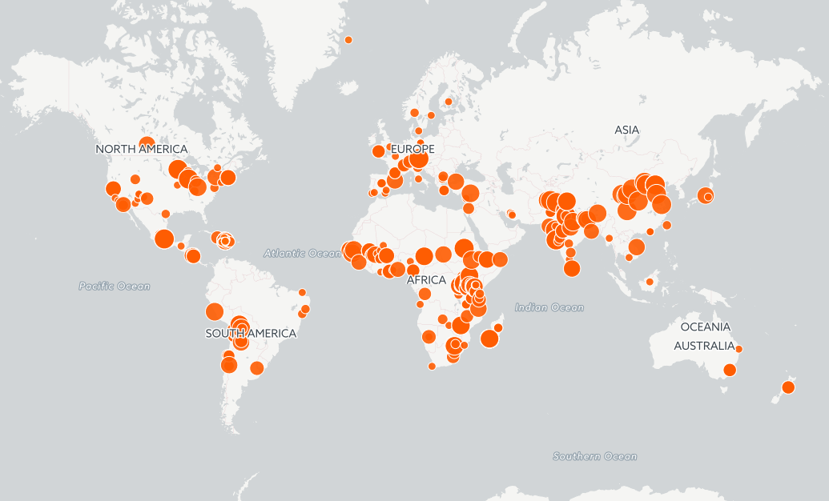
Why solar cooking?
3.3+ million solar cookers worldwide
(and counting…)
11.8+ million people directly impacted
by solar thermal cooking
6 billion meals cooked via solar thermal
Reduce CO2 emissions by 23 million tons
$200 billion in potential savings
and benefits annually (World Bank estimate, 2016)

Slide 9
How does solar cooking support the SDGs?

Slide 10
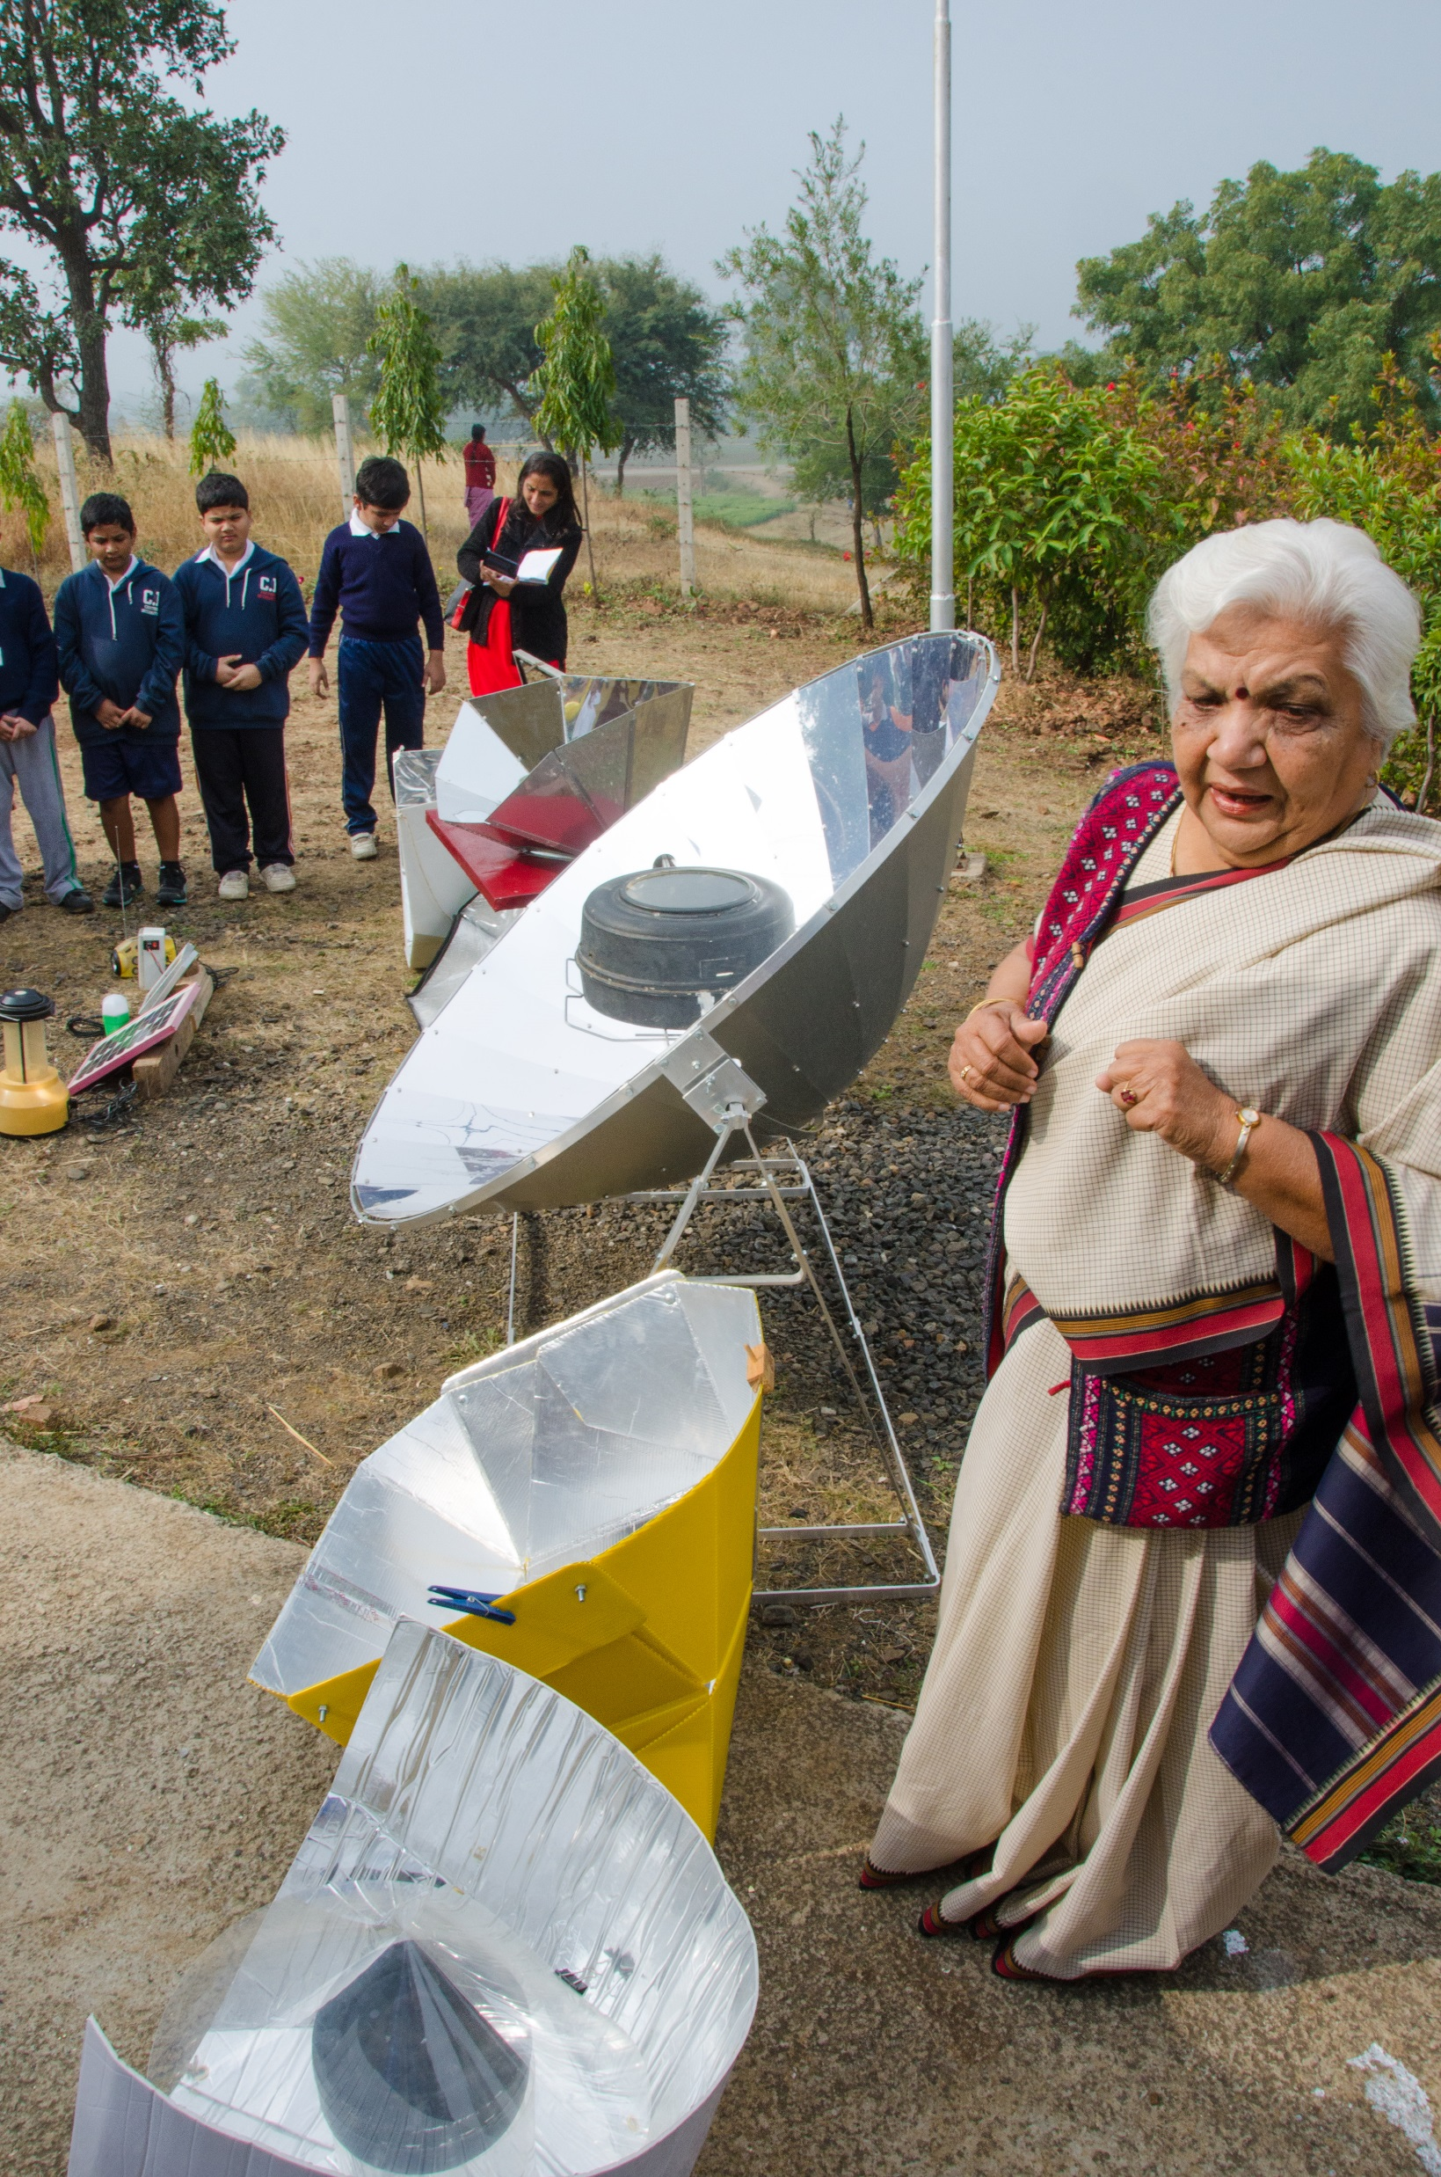
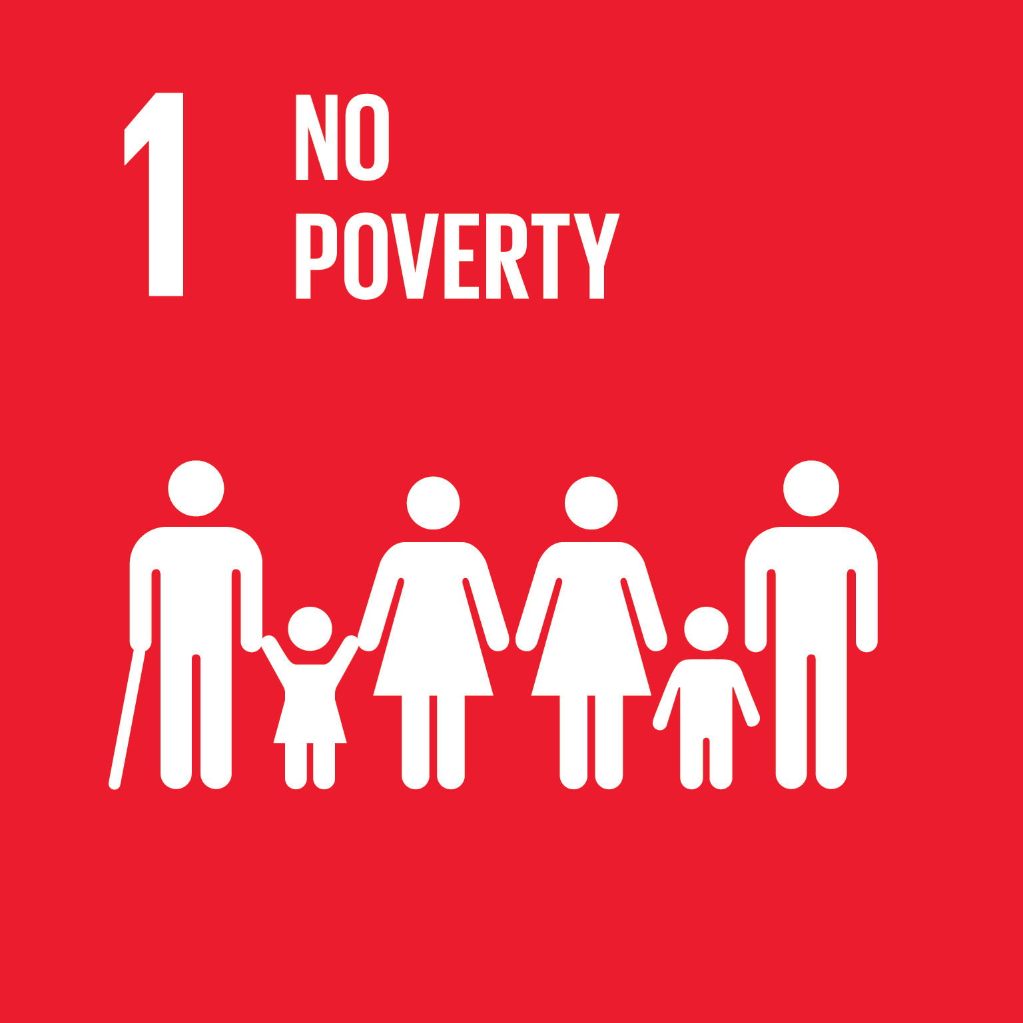
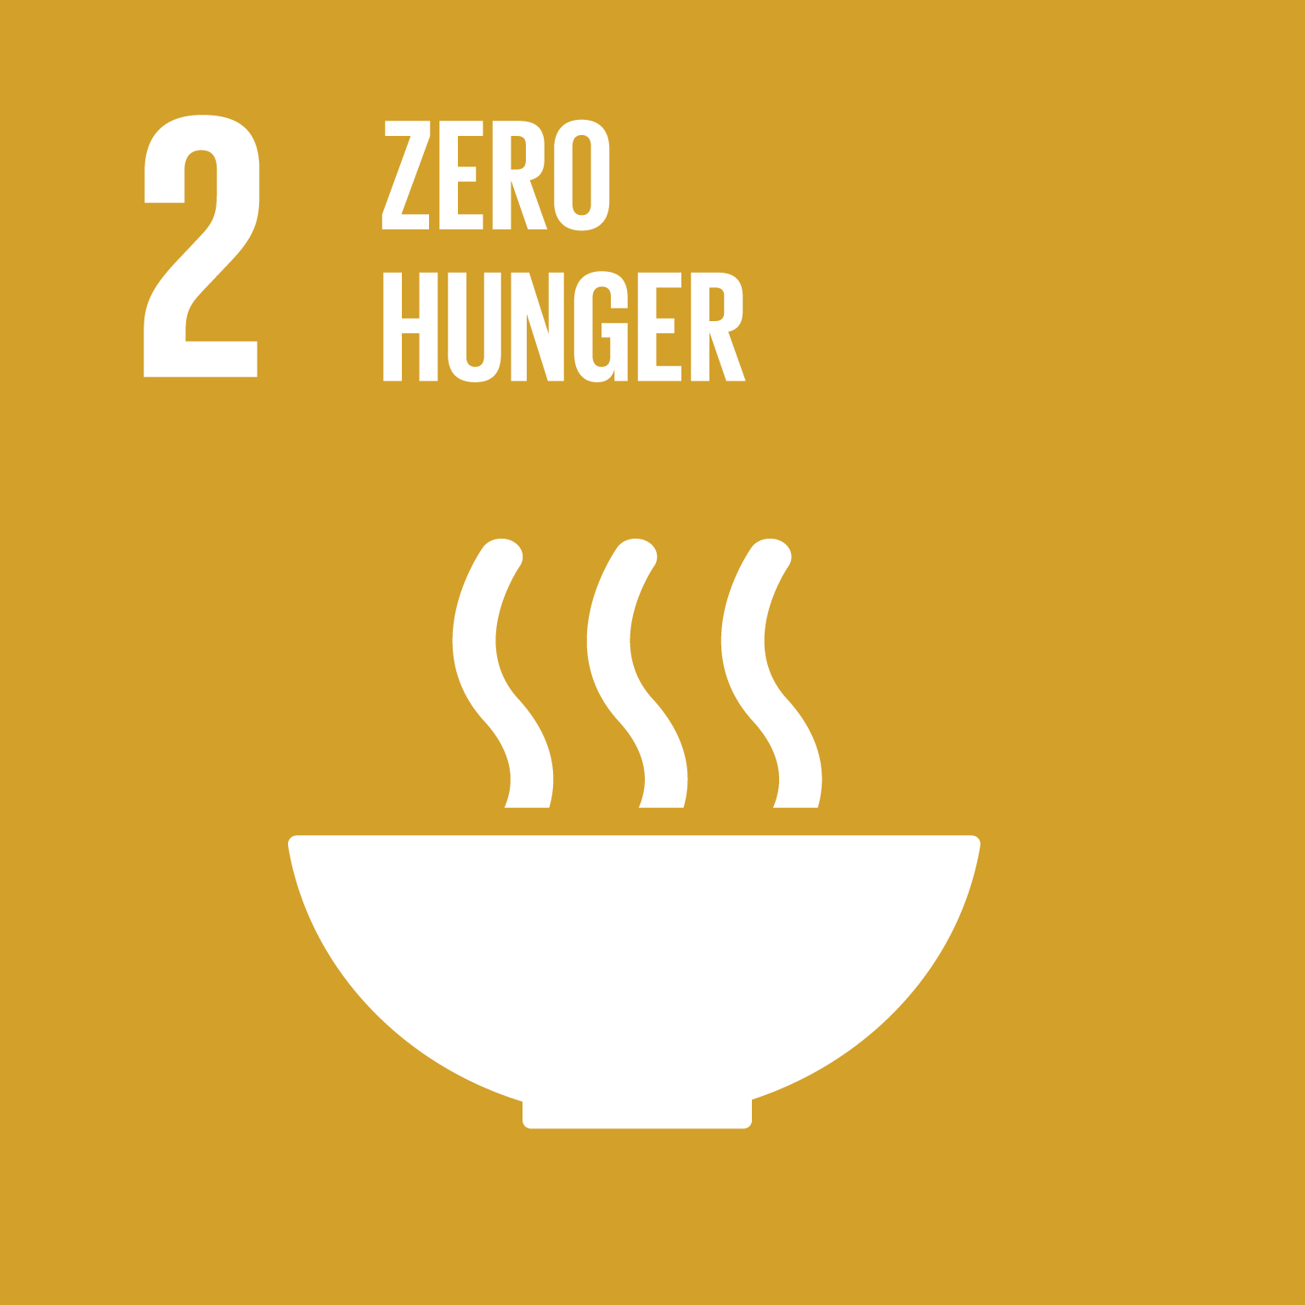
How does solar cooking support the SDGs?
Up to 40% of household energy budgets are used for heating water and cooking. Access to free solar energy through appropriate technologies reduces costs and financial burden.
Nutritious foods (pulses and legumes) require large amounts of fuels to cook. Solar thermal energy enables families to cook nutritional and traditional foods, building resilience for food price and fuel price volatility.
Household air pollution is the number one cause of disease. Solar cooking does not produce smoke or other harmful emissions that harm women and children.
Because there is no fuel to collect for solar cooking, time can be used for education and study.

Slide 11
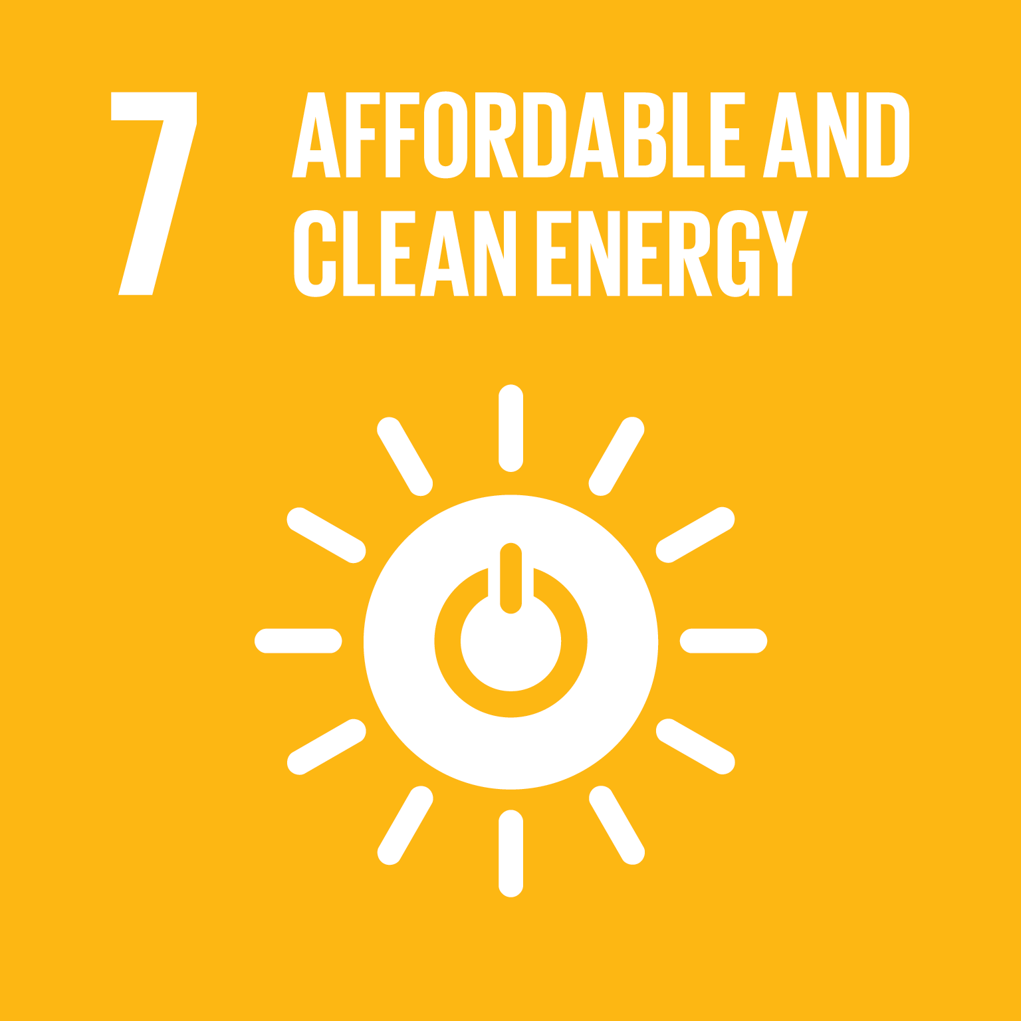
How does solar cooking support the SDGs?
Providing cooking fuel has been the domain of women and girls. Since solar cooking requires no fuel, women and children gain time for other activities, including education and business.
Solar cookers can pasteurize water, making local water sources safe for consumption while addressing issues of disease and scarcity.
Solar energy is true modern energy: it requires no gathering or purchase, is available everywhere, does not rely on supply chains, and has the highest energy efficiency of all energy sources.
Solar cooking frees up time and money for other activities, including education which leads to productive employment.

Slide 12
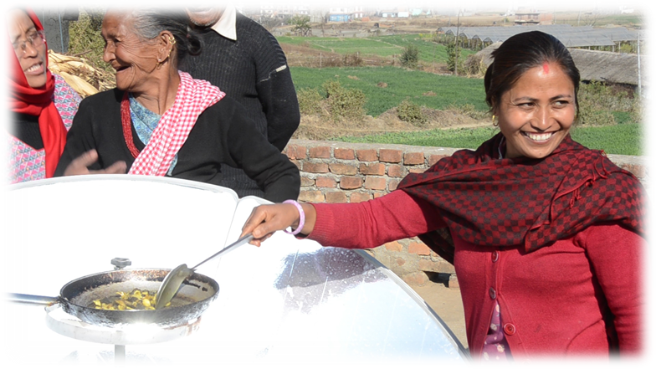
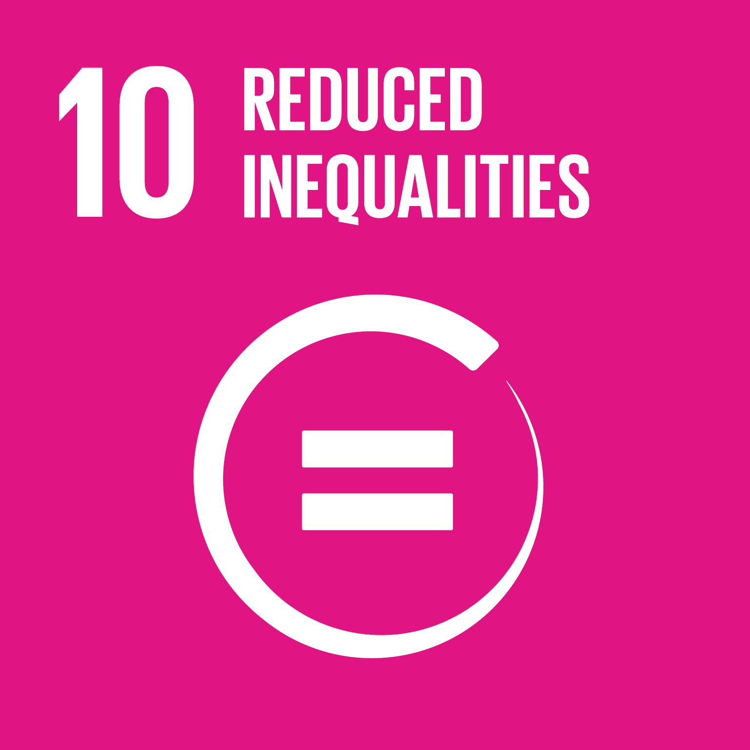
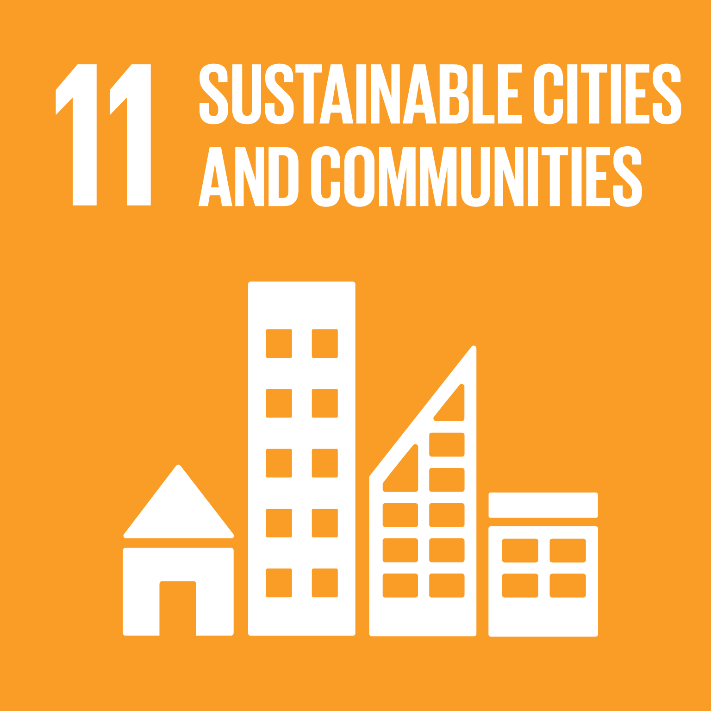
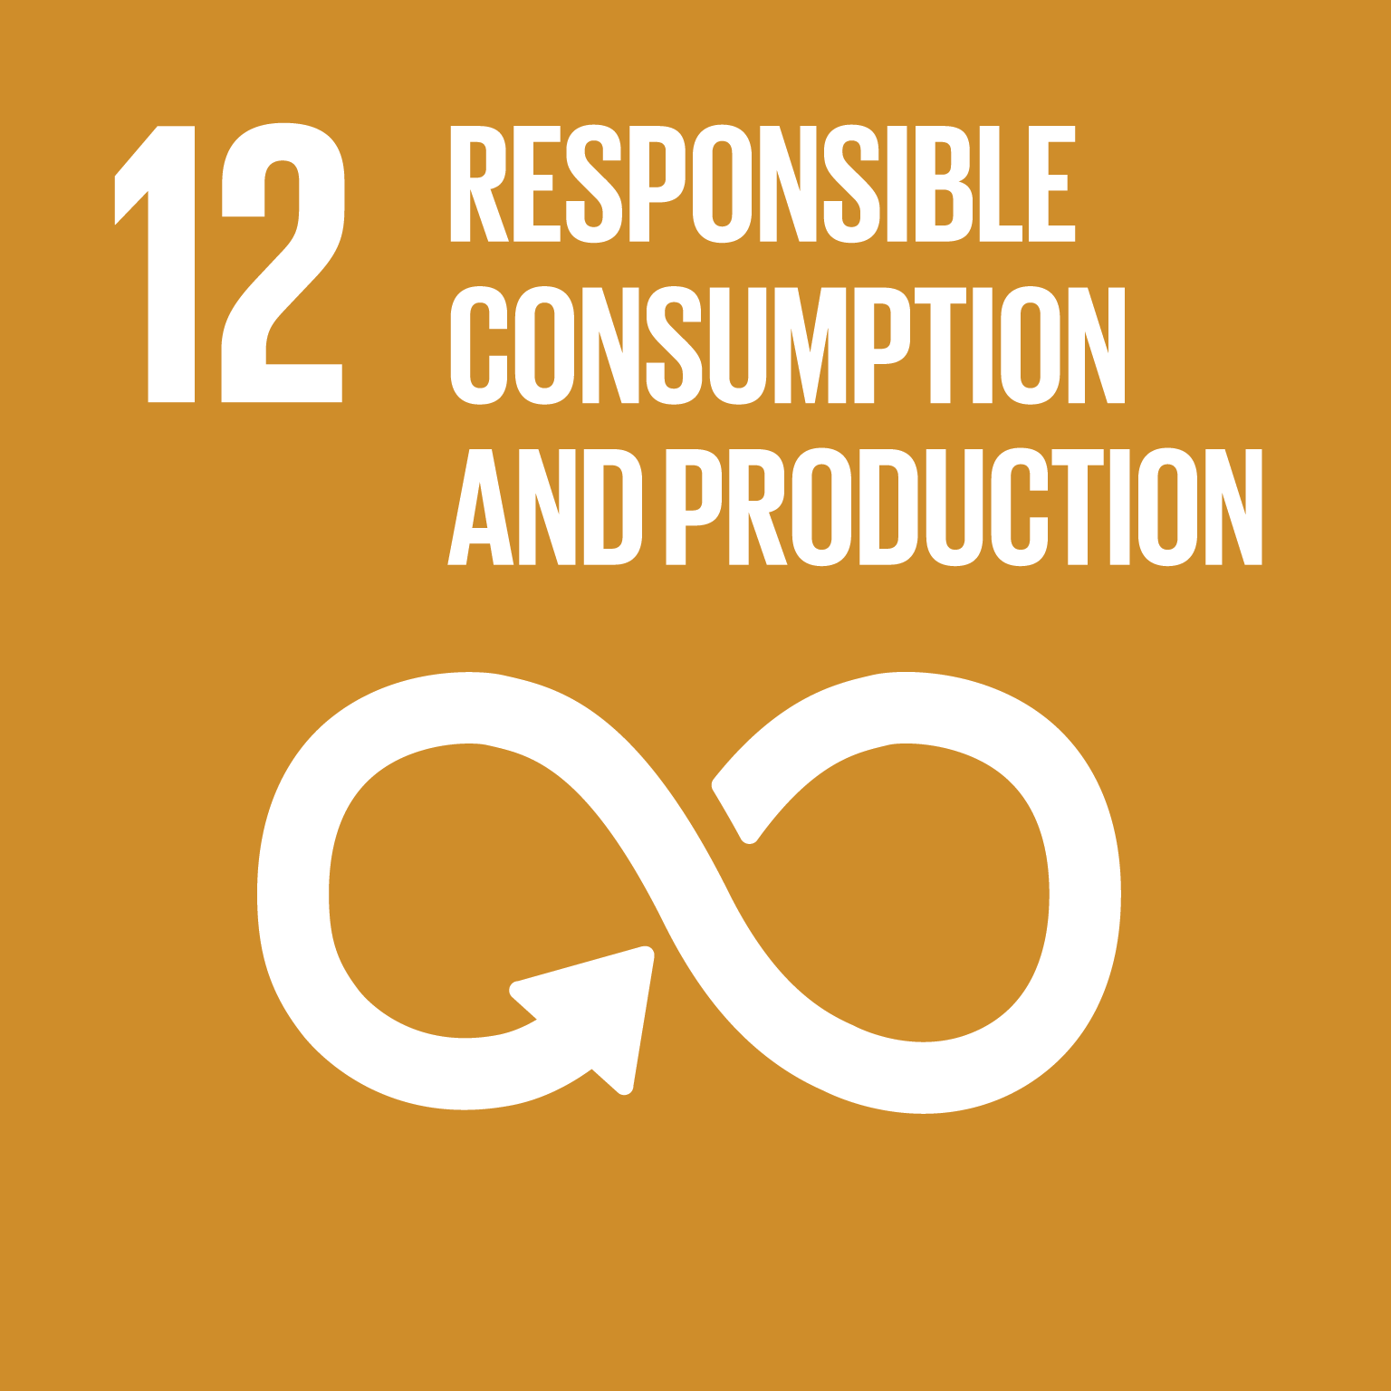
How does solar cooking support the SDGs?
Solar cooking technologies are accessible to local innovators and provide access to decentralized energy, ultimately supporting economic development and stability.
Solar energy is of proportionally higher value to the bottom 40% of the global population, who will benefit most from increased access to decentralized, free energy.
Solar energy can be captured for household and institutional uses in urban settings where biomass fuels are not available, reducing reliance on expensive fossil fuels for cooking and water pasteurization. Accessing solar energy sources reduces competition for energy, reducing human conflict in high-density settings.
Enough solar energy reaches the Earth’s surface every hour to power all human activity for a year. Decentralized use of solar energy contributes to sustainable patterns of energy consumption, reducing market distortions.

Slide 13
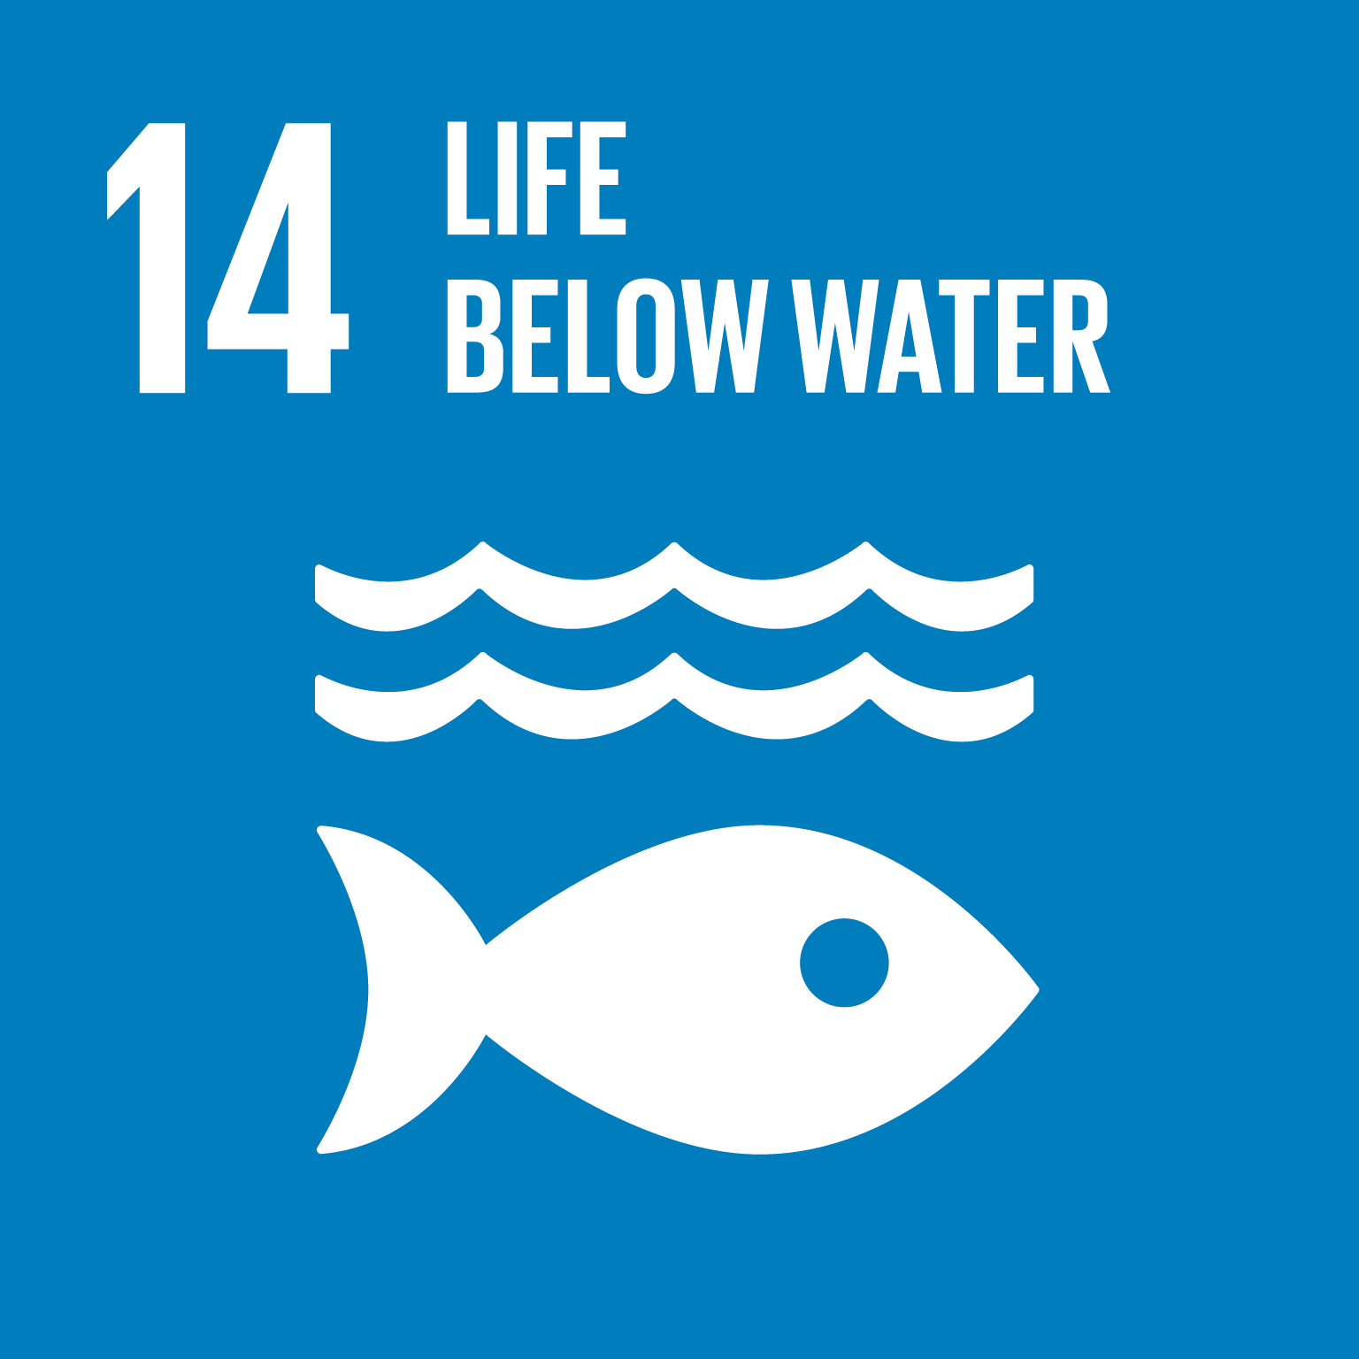
How does solar cooking support the SDGs?
Use of free, zero-emission solar energy reduces production of climate change forcing agents, such as greenhouse gases and black carbon produced by fossil and other biomass fuels.
Replacing biomass combustion fires with solar energy helps promote preservation of healthy biomass and significantly reduces marine pollution from land-based activities.
The rate of deforestation and desertification is slowed when solar energy replaces harvested biomass fuels. Solar cooking and water pasteurization supports forest management, halts land degradation, and arrests desertification and marine pollution.
Access to free solar thermal energy is essential to achieve two of humankind’s most important rights: cooked food and safe water. Solar energy is the ultimate inclusive energy source—by reducing competition for scarce or expensive fuels, it reduces human conflict.

Slide 14
How does solar cooking support the SDGs?
The solar thermal cooking sector has a strong history of appropriate technology. Knowledge sharing for solar thermal cooking innovations strengthens and empowers community members, particularly women, to be change agents for revitalized, sustainable development.
Solar Cookers International
www.solarcookers.org
More Information on solar cooking:
www.solarcooking.org

Slide 15
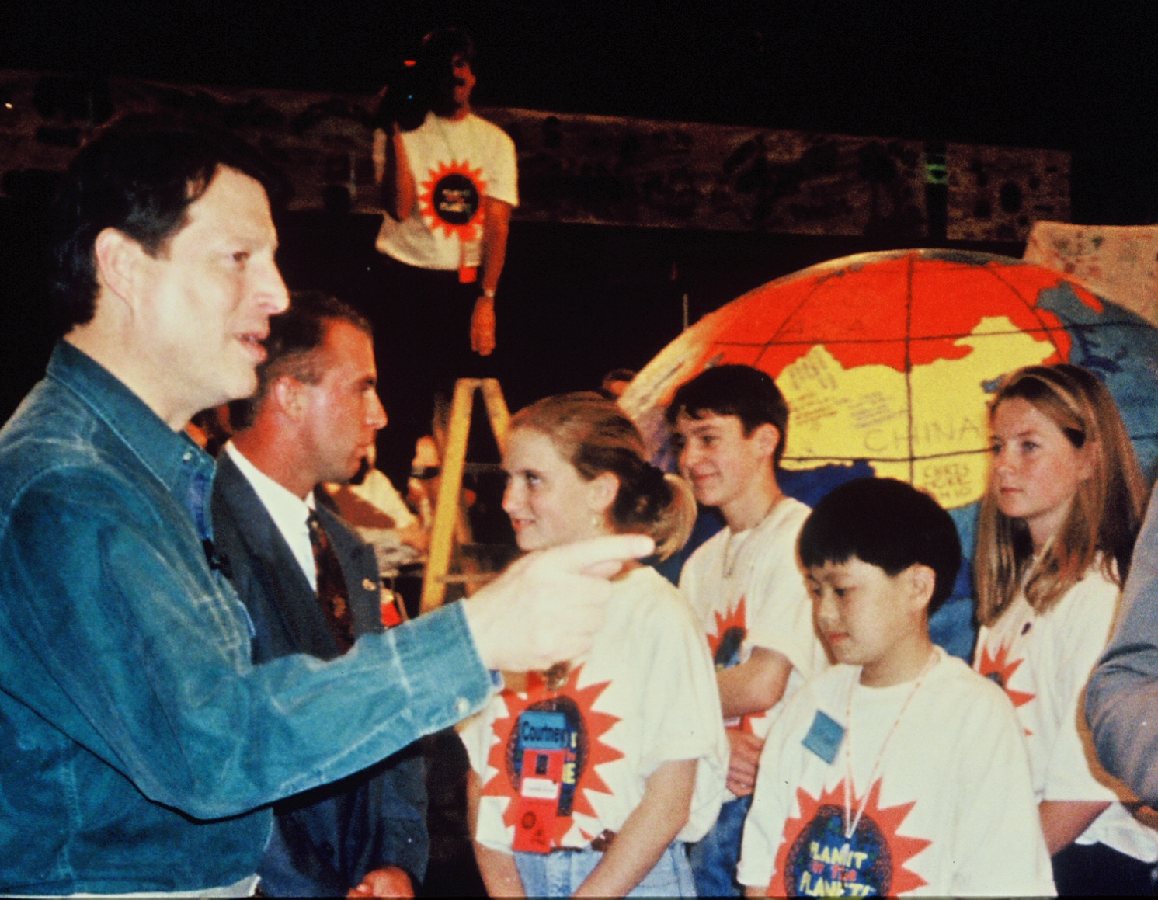
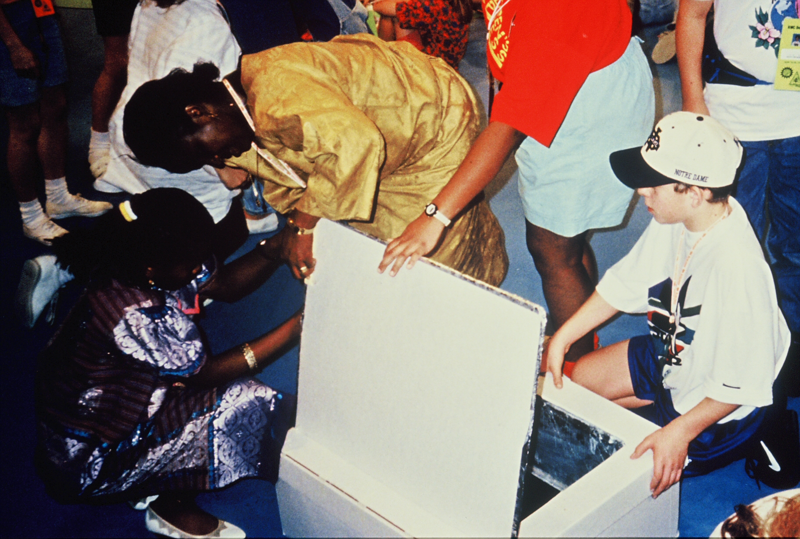
Solar cooking: a strong history
Al Gore and Solar Cookers International at Nickelodeon Studios in 1993 discussing environmental solutions.

